Slide 1

Reading Enterprise Architecture Artifacts

Slide 2
Just What the Heck IS Enterprise Architecture??
Wikipedia: “Enterprise Architecture applies architecture principles and practices to guide organizations through the business, information, process, and technology changes necessary to execute their strategies.”
Key Point:
For 99% of what EA does, it’s STRATEGIC

Slide 3
EA’s Role with a New Initiative
Customer has business needs that can be enabled by using technology and requests analysis
Enterprise Architecture conducts analysis and creates artifacts to assist with requirements building.
Once a project has been green-lighted by CIO or DDAC (or Department has funding of their own), an RFI / RFP Gets created with the EA artifacts included.
EA Team participates in Demo’s and provides technical counsel for initial selection of Product. Alternatively, EA provides technical Counsel to internal development teams if the solution is going to be developed in-house.

Slide 4


Why is EA needed? Well sometimes things are not what they seem…

Slide 5
What Artifacts are normally created by the EA team?
Capability Area Architecture
Logical Data Model
System Context Diagram
Sequence Diagram
Activity Diagram
Use Case Diagram
Interaction Overview Diagram

Slide 6
System Context Diagram
Capability Area Architecture
Logical Data Model
System Context Diagram
Sequence Diagram
Activity Diagram
Use Case Diagram
Interaction Overview Diagram

Slide 7
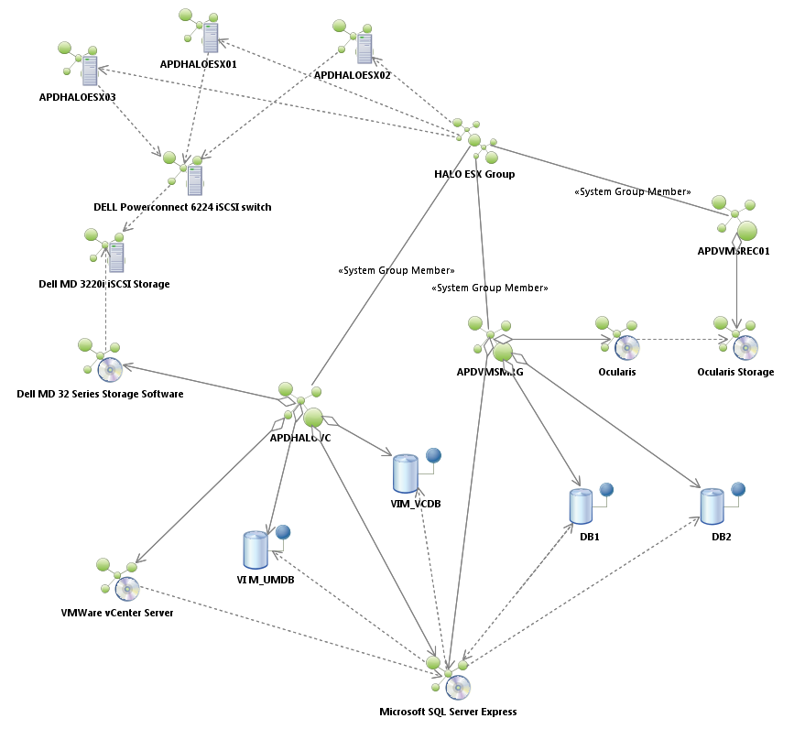
System Context Diagram
System Context diagrams show the physical layout a solution space.
This is the only time EA isn’t strategic and becomes more tactical!

Slide 8
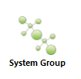
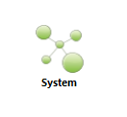
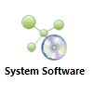
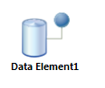
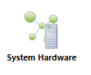
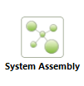
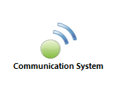
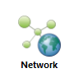
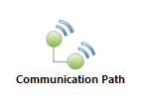
System Context Diagram
Communication paths indicate an association between two things through which they can communicate signals and messages.
Between two devices, it typically denotes a physical connection between two nodes, Like Ethernet.
Between two environments, it typically denotes a protocol (like TCP/IP)
Sometimes, when you are architecting very very large systems with multiple major systems, you want to represent pieces as a single unit. Sometimes we designate hardware like Routers, keyboards, scanners – contained hardware items with this icon. System Assembly’s are for this purpose!
If you are architecting a widely distributed system that includes communication components like microwave towers, the communication system icon is used to convey a system that manages communication!
This represents the presence of a system that is managing a network. You normally won’t see this unless the diagram is focusing on elements that provide the network managing system for a specific reason.
Data Elements indicate a data store of some kind. It might be a file, it might be a table. You can tell more about it based on with what it’s associated. You often see Oracle Servers or SQL Server software pieces associated/Dependent with data elements!
A System Group indicates a cluster of systems, like a VM farm – it’s a mechanism for providing other system spaces.
A System without the little computer next to it normally implies a VM, something without actual hardware. Normally, supplied by a System Group!
System software is any software product. It’s easy to remember – it has a little DVD built into the Icon
System Hardware is any system that has a physical box associated with it. It’s easy to remember – it has a little Computer Tower built into the Icon
An Aggregate association. The thing being pointed to is part of the thing that has the diamond
A Dependency association. The thing being pointed to is critical for the thing from which the arrow originates

Slide 9
System Context Diagram
So Let’s look at the System context diagram again

Slide 10
Capability Area Architecture

Slide 11
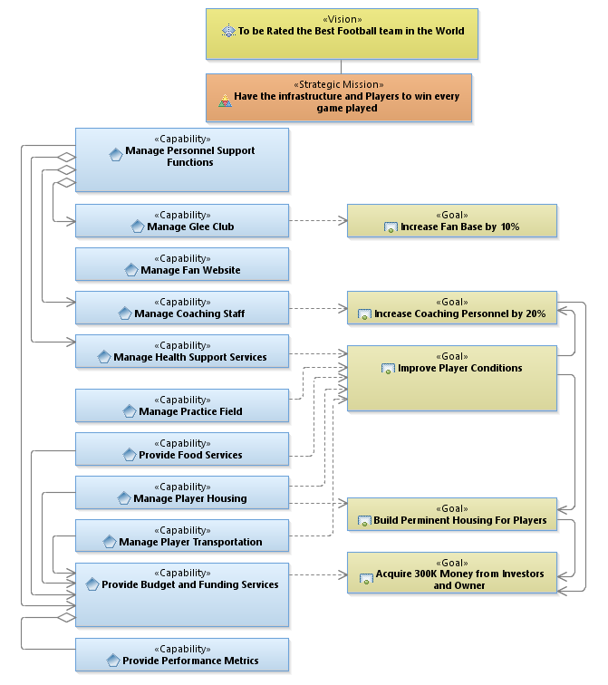
Capability Area Architecture
A Vision
A Mission
A Vision Is a State.
Some point in the future it will look like “this”.
Example: The Vision… to be rated the best Football team in the world!
A Mission is a summary of capabilities. It describes the organizations purpose.
Example: Have the Infrastructure and players to win every game played.

Slide 12
Capability Area Architecture
This indicates that one thing on our chart is part of another thing.
In this chart, the “Manage Glee Club” Capability is part of “Manage Personnel Support Functions” capability
A Capability
This indicates when capabilities are dependent on goals.
Often we see many Capabilities dependent on one or more of the same goals… this is how we decide the best places to start!
An Aggregate
A Goal
A Capability is a collection of people, processes, and technology that deliver value, achieve outcomes / effects / goals.
Example: “Manage Personnel Support Functions”
A Goal is an outcome which will aid in moving the Capability forward in its intent. Goals amplify and quantify the organization’s Vision!
Example: “Increase Fan Base by 10%”
A Dependency

Slide 13
Capability Area Architecture
This is used to indicate a relationship or to indicate a planned order based on dependencies.
A Directed Association

Slide 14
Logical Data Model
Capability Area Architecture
Logical Data Model
System Context Diagram
Sequence Diagram
Activity Diagram
Use Case Diagram
Interaction Overview Diagram

Slide 15
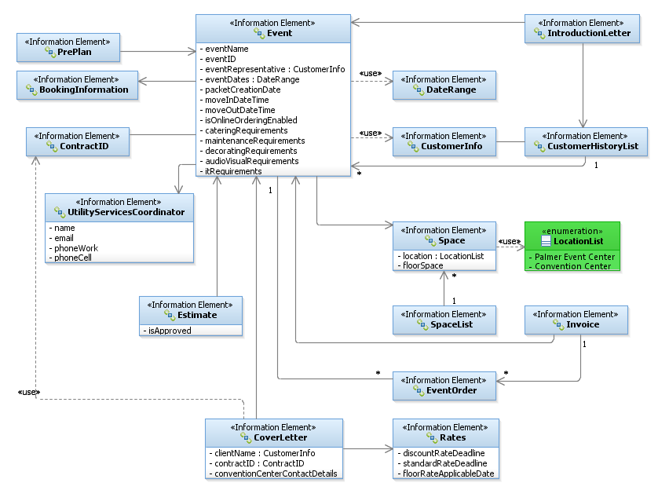
Logical Data Model
An Information
Element
An Enumeration
This describes a collection of discrete values for a kind of attribute. Think of it as an equivalent to a drop down menu of choices. The associated attribute can ONLY have the values listed.
This describes an Object used within our solution space, and its associated attributes (if there are any). It can be data at rest or data moving throughout a system.

Slide 16
Logical Data Model
Just like in Capability Area Architectures, a Directed Association tells us when one thing is part of another – literally. Think of the object being pointed to, as a subset of the thing pointing! If there’s no Arrow head and it’s a single line, that means both things contain each other.
In this example, the “Event” object contains the “BookingInformation” object
Multiplicity
This describes a dependency between one object and another. In this example, the Event depends on the DateRange object.
Multiplicity indicates a kind of referential relationship. Like a group of child records that belong to a parent. They include a range of possibilities.. 0,1…*
A Directed Association
A Dependency

Slide 17
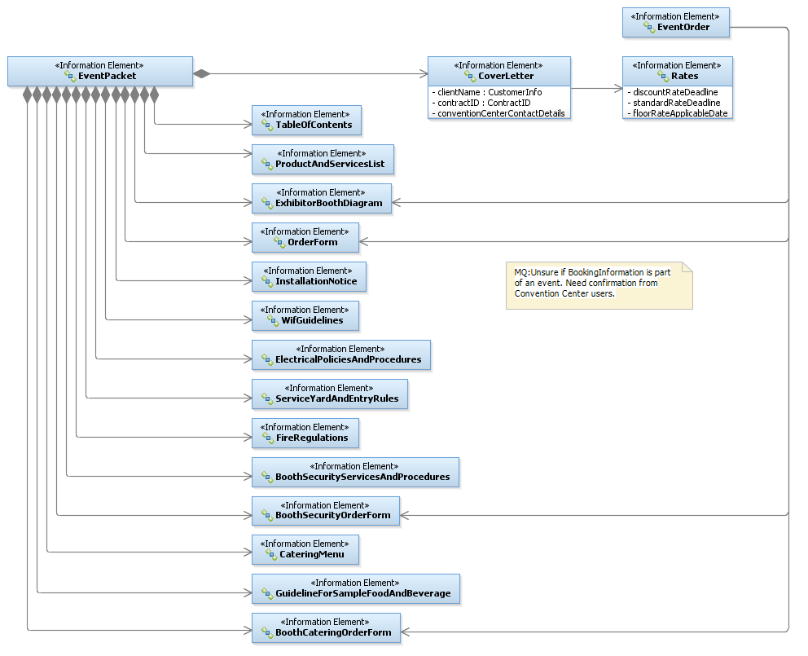
Logical Data Model
This indicates the things without the diamond are part of the thing with the diamond – as in literally a Kit…a collection of things. If you see this without the diamond filled in, it’s called “Aggregation”, implies the same kind of “kit” but implies the items are optional in the kit…if they exist they are part of the object.
A note is any important piece of information that’s related to the item to which it’s attached. They look like post-it notes!
Composition
A Note

Slide 18
Use Case Diagram
Capability Area Architecture
Logical Data Model
System Context Diagram
Sequence Diagram
Activity Diagram
Use Case Diagram
Interaction Overview Diagram

Slide 19
Use Case Diagram
In software and system engineering, a use case is a set of steps, typically defining interactions between a role (known in UML as an "actor") and a system, to achieve a goal also referred to as result of value (ROV). The actor can be a human or a system.
Think of a Use Case Diagram, as a 10,000 foot level look at your process. It shows who or what is affiliated with the Use Case being defined. It can also indicate important data to the process (things that trigger the process or that are produced from the process.) It is NOT a data flow, nor does it indicate anything other than the players in the process.

Slide 20
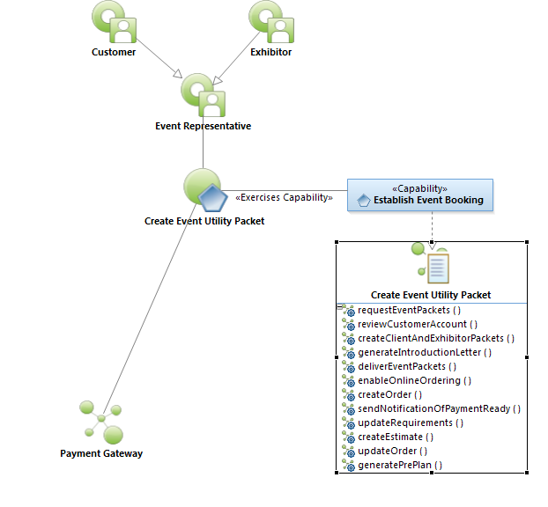
Symbols to know to read a Use Case!
Use Case Diagram
A Role
Abstraction of a Role
The Use Case Name
The Capability this Use Case Supports
A System that’s used in the Use Case
System Function Specification

Slide 21
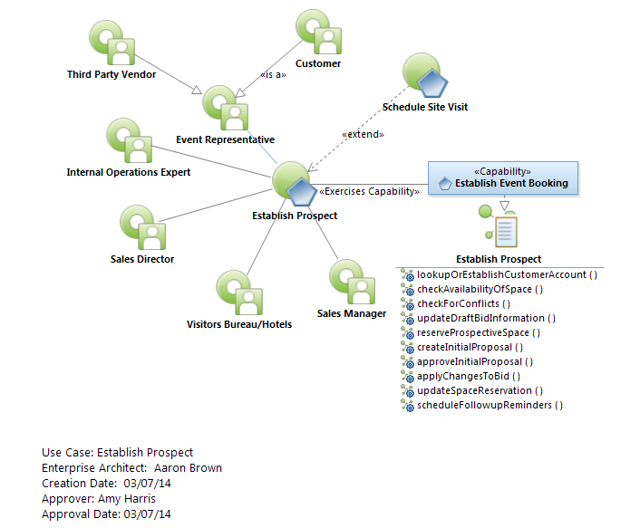
Use Case Diagram
<<Extend>>: Another use case MIGHT be called
<<Include>>: Another Use Case WILL be called
Extends / Includes
10000 Foot View
The Use Case ID Block

Slide 22
Sequence Diagram
Capability Area Architecture
Logical Data Model
System Context Diagram
Sequence Diagram
Activity Diagram
Use Case Diagram
Interaction Overview Diagram

Slide 23
Sequence Diagram
A Sequence diagram shows a process broken into a sequence of messages between objects, arranged in time sequence. It shows the sequence of messages and the objects needed to carry out the functionality of the scenario. Sequence Diagrams typically are associated with Use Case “realizations” as a logical view of a system.

Slide 24
Sequence Diagram
doMyImportantFunction( :data1, :formInfo) : rtnval
These are arguments for our function. They are values we pass to, get from, and pass in-and-out of the function. We can have as many arguments as we like.They are separated by a comma. Normally these have already been defined in our logical data model and are well known objects at this point.
Sometimes there is a “state” specified before the data object that helps the reader understand more about what’s going on.
doMyProcess(initial: data1 , completed:formInfo)
Just like in programming, a function can return a single value. It doesn’t have to. It might return information in the data objects we passed to it, but sometimes we want to return a value to insure successful execution of something. So we indicate it will pass us back a return value and then we predicate some other action on this value.
This is a function. A message. A request. Call it what you like. We often put the word “Please” in front of it to make sure it is properly formed. It’s what we are asking another role (system, database, person) to do for us.

Slide 25
Sequence Diagram
Roles (Actors)
Person 1
System 1
Database 1
verifyLoginInfo( :Credentials) : status
Time progresses
verifyLoginInfo( :Credentials) : status
The arrow head says who is doing this activity
When a role does something on its own without another actor, we call it a reflexive
displayPersonMenu( :PersonInfo)
promptForOption( :PersonInfo, :MenuX)
selectMyOption( selected:OptionChoice, :MenuX)

Slide 26
Sequence Diagram
Roles (Actors)
Person 1
System 1
Database 1
verifyLoginInfo( :Credentials) : status
Time progresses
verifyLoginInfo( :Credentials) : status
Sequence diagrams can have Option blocks that provide optional pieces of code, designated by OPT, and a Guard Condition (when it’s executed)
OPT
[status is success]
displayPersonMenu( :PersonInfo)
promptForOption( :PersonInfo, :MenuX)

Slide 27
Sequence Diagram
Roles (Actors)
Person 1
System 1
Database 1
Sequence diagrams can have Alt blocks that provide optional pieces of code, designated by ALT, and a Guard Conditions (when it’s executed). An Alt block can have as many alternate paths and Guard conditions as needed!
ALT
[status is success]
displayPersonMenu( :PersonInfo)
Time progresses
promptForOption( :PersonInfo, :MenuX)
[status is unknown]
dumpProgram( :PersonInfo)
[status is bad password]
promptForPsw( :PersonInfo)

Slide 28
Sequence Diagram
Roles (Actors)
Person 1
System 1
Database 1
Sequence diagrams can have Loop blocks that provide optional pieces of code, designated by LOOP, and a Guard Conditions (the maximum number of loops, and the conditions by which the loop ends)
lookupNextDistrict( :District, :TheQue )
Time progresses
LOOP
[0,*] [for each item in list]
displayDistrict Info( :District )
lookupNextDistrict( :District, :TheQue )

Slide 29
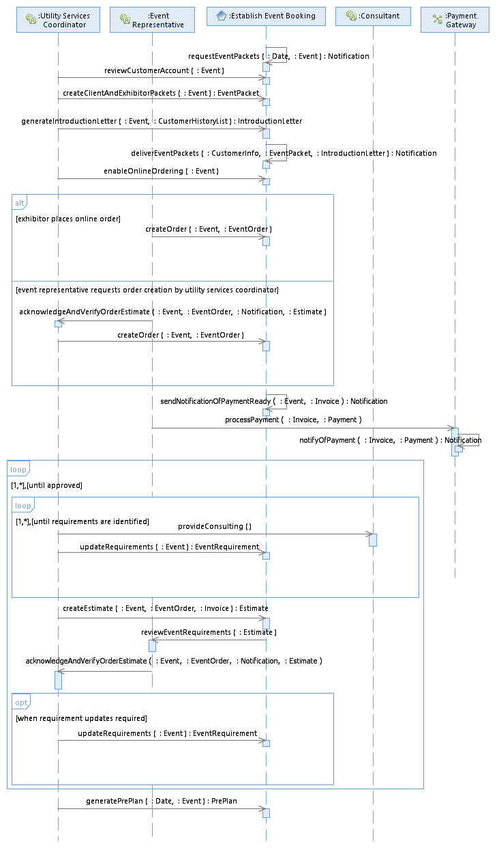
Sequence Diagram
Here is the associated sequence diagram for the “Create Event Utility Packet” use case done for the Convention Center.
All Sequence Diagrams have an accompanying table that describes each function in great detail. This accompanies the Sequence Diagram when it’s provided in an RFI or RFP. This is the most critical part of a sequence diagram as it indicates the detail associated with each step.
Type/Interface | Description
Establish Event Booking/ requestEventPackets | 3-6 months prior to an Event, the system sends a Notification to the Utility Services Coordinator instructing them to create Event Packets for the Client and the Exhibitor, providing the contract ID, event name, space, notes from sales, etc. The system requests Utility Services Coordinator to verify auto-reassigned traces.
Establish Event Booking/ reviewCustomerAccount | The Utility Services Coordinator uses the system to review type of event, dates, space, booking notes, and contract clauses for accuracy. The system allows the Utility Services Coordinator to make changes as necessary, recording who made the change, the date the change was made and by whom.
Establish Event Booking/ createClientAndExhibitorPackets | The Utility Services Coordinator uses the System to create the Client and Exhibitor Packets based on templates. Event Packets include the following: (1) cover letter (client name, contract ID, event name, show dates, move in/out dates, discount rate deadlines, standard rate deadlines, floor rate applicable date, contact information for Austin Convention Center, name and contact information of utility services coordinator), (2) Table of contents, (3) List of all products…
…. | ….

Slide 30
Activity Diagram
Capability Area Architecture
Logical Data Model
System Context Diagram
Sequence Diagram
Activity Diagram
Use Case Diagram
Interaction Overview Diagram

Slide 31
Activity Diagram
Activity Diagrams are graphical representations of workflows of stepwise activities and actions with support for choice, iteration and concurrency. They describe business and operational step-by-step workflows of components in a system.
Activity Diagrams normally designate process and people more than system. Often Activity Diagrams don’t even list the systems of concern.

Slide 32
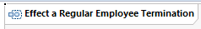
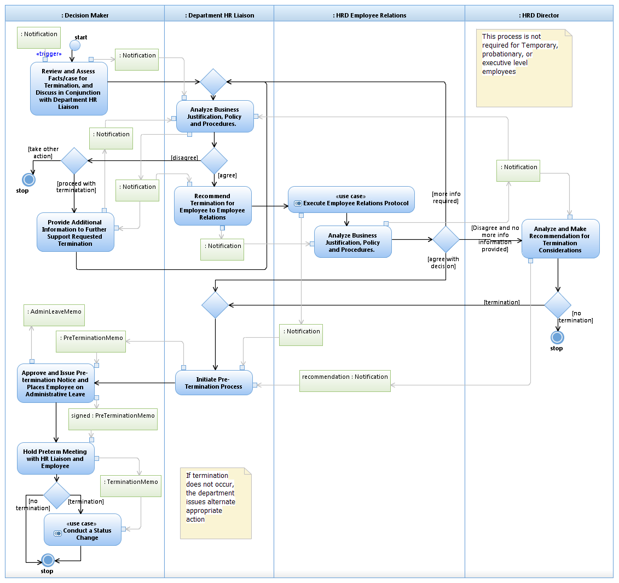
Activity Diagram
Roles (Actors)
Processes
Data
Activity Diagrams focus on Activities of specific roles and the data required for them to do tasks. This is why they are perfect for depicting workflows!
Notice there is no system represented on this diagram!
A swim lane

Slide 33
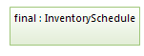
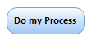
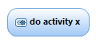
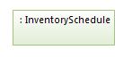
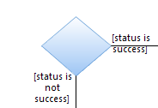
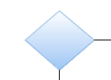
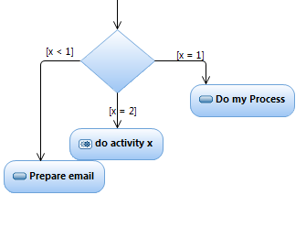
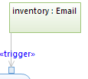
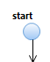
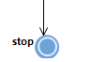
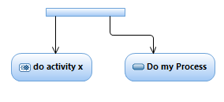
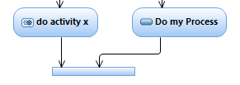
Activity Diagram
Concurrent activities are denoted by the FORK object. It can be used to denote when multiple processes execute simultaneously. Any number of process paths can be forked.
Every Process will have a control buffer as an input and as an output (at a minimum… there can be as many control buffers as desired). The first process normally includes a control buffer with the word <<trigger>> this indicates the data that triggers the beginning of the process. Control Buffers attach to processes with little arrows called “Pins” The arrows tell us if it’s an input or an output based on their direction.
Any time concurrent activities are FORKed, they terminate either with a stop, or a JOIN object. It’s used to denote a synchronization of the processes attached to it. Any number of process paths can be Joined.
This is called a Central Buffer. It holds data and is attached to process bubbles indicating the data either going into a process or coming from a process. The Data should be part of our logical data model! Note: Central buffers can be anywhere on a diagram and have no relation to the swimlane in which they exist. Sometimes they also include a state modifier like sequence diagrams.
This is a decision block. You can tell it’s a decision block because it will have guard conditions that indicate when you traverse that path. Note…there can be MANY MANY paths of a decision block, not just two.
This is a Merge block. You can tell it’s a merge block because it doesn’t have guard conditions. Since Activity Diagrams don’t have loops, these are used to provide a way to circle back logic. There is no limit to the number of paths that can be merged.
This Blue Oval with the Gear means a process that exists in another activity or sequence diagram. Remember the <<include>> and <<extend>> designations in the Use Case Diagram? There should be one of these for every one of those.
This Blue Oval means a process is being done by the Role (actor) in whose swim lane it is drawn. It always starts with an action verb. Note – processes can only have 1 in and 1 out.
Every Activity Diagram ends with a STOP element. There can be many stop objects and they can have multiple processes terminate at each. This is where the scope of the process being mapped, ends.
Every Activity Diagram begins with a START element. There will only be 1 Start object per diagram.

Slide 34
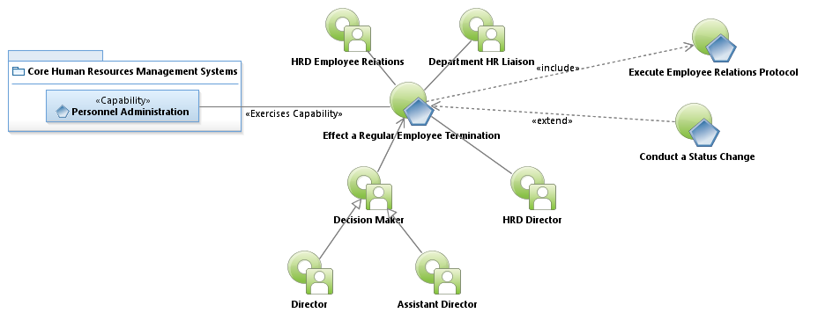
Activity Diagram
Here’s the Use Case for the Activity Diagram

Slide 35
Activity Diagram
Now let’s take another look at the Activity Diagram.

Slide 36
Interaction Overview Diagram
Capability Area Architecture
Logical Data Model
System Context Diagram
Sequence Diagram
Activity Diagram
Use Case Diagram
Interaction Overview Diagram

Slide 37
Interaction Overview Diagram
Interaction Overview Diagrams are used to step up one level and show the data and interactions of multiple use cases. They follow all the constructs of Activity Diagrams (and in truth they are another form of Activity Diagram in the COA implementation.) They have no swimlanes nor roles, and are focused on data movement throughout the model.

Slide 38
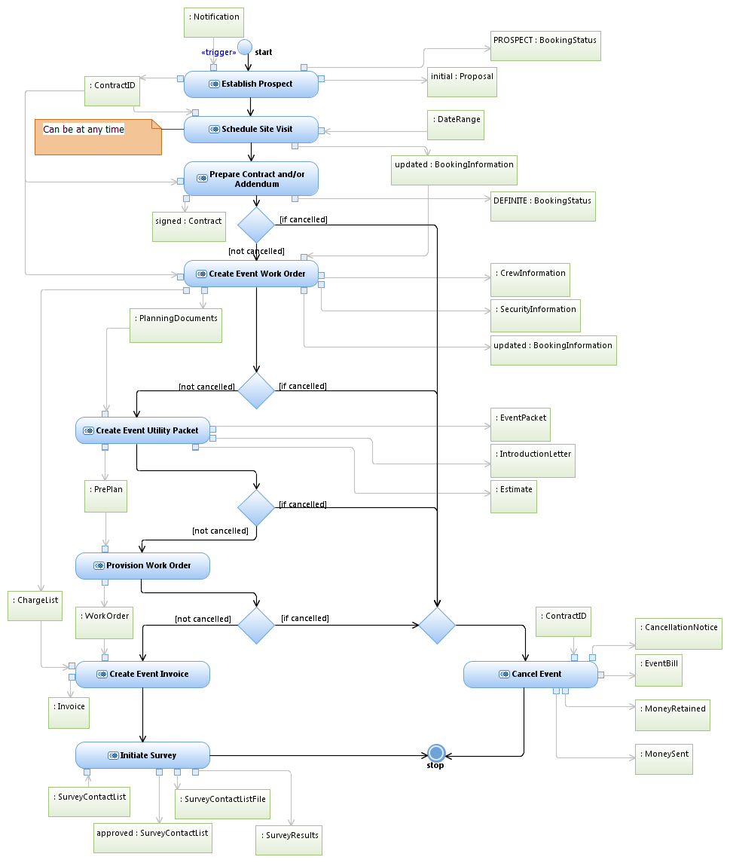
Interaction Overview Diagram
Interaction Overview Diagrams are used to step up one level and show the data and interactions between processes of a major system

Slide 39

Questions

Slide 40
Aaron Brown
Sr. IT Enterprise Architect
Aaron.brown2@austintexas.gov
512-974-2960

